Slide 1

Database Design for Tracking Students, Alumni, and Job Opportunities
Author: Anh Tuan Hoang

Slide 2

Introduction
Purpose
Scope
Track and manage data for students, alumni, jobs, and recruiters.
Facilitate job recommendations and data-driven insights.
Support recruiters, companies, and administrators.
Database for handling students, alumni, departments, and job postings.
Overview
Automated processes through triggers and stored procedures.
Optimized queries and secure data handling.
Comprehensive schema design.

Slide 3

Requirements Analysis
Functional Requirements:
CRUD operations for all entities.
Job recommendations for alumni and students.
Secure data access based on user roles.
Non-Functional Requirements:
Scalable database to support 40,000+ alumni.
High performance with optimized indexes.
Role-based security and encrypted sensitive data.
Assumptions:
Alumni can also be students.
Departments maintain job relevance weights.

Slide 4
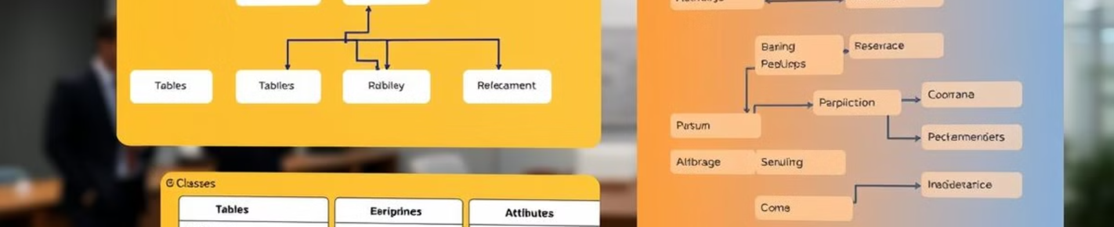
Database Design: The Foundation
Entity-Relationship Diagram
Normalization
3
UML Diagram
1
2
Ensures data integrity and eliminates redundancy
Detailed representation of classes, attributes, and methods
Visual representation of entities and their relationships, including 7 core entities

Slide 5
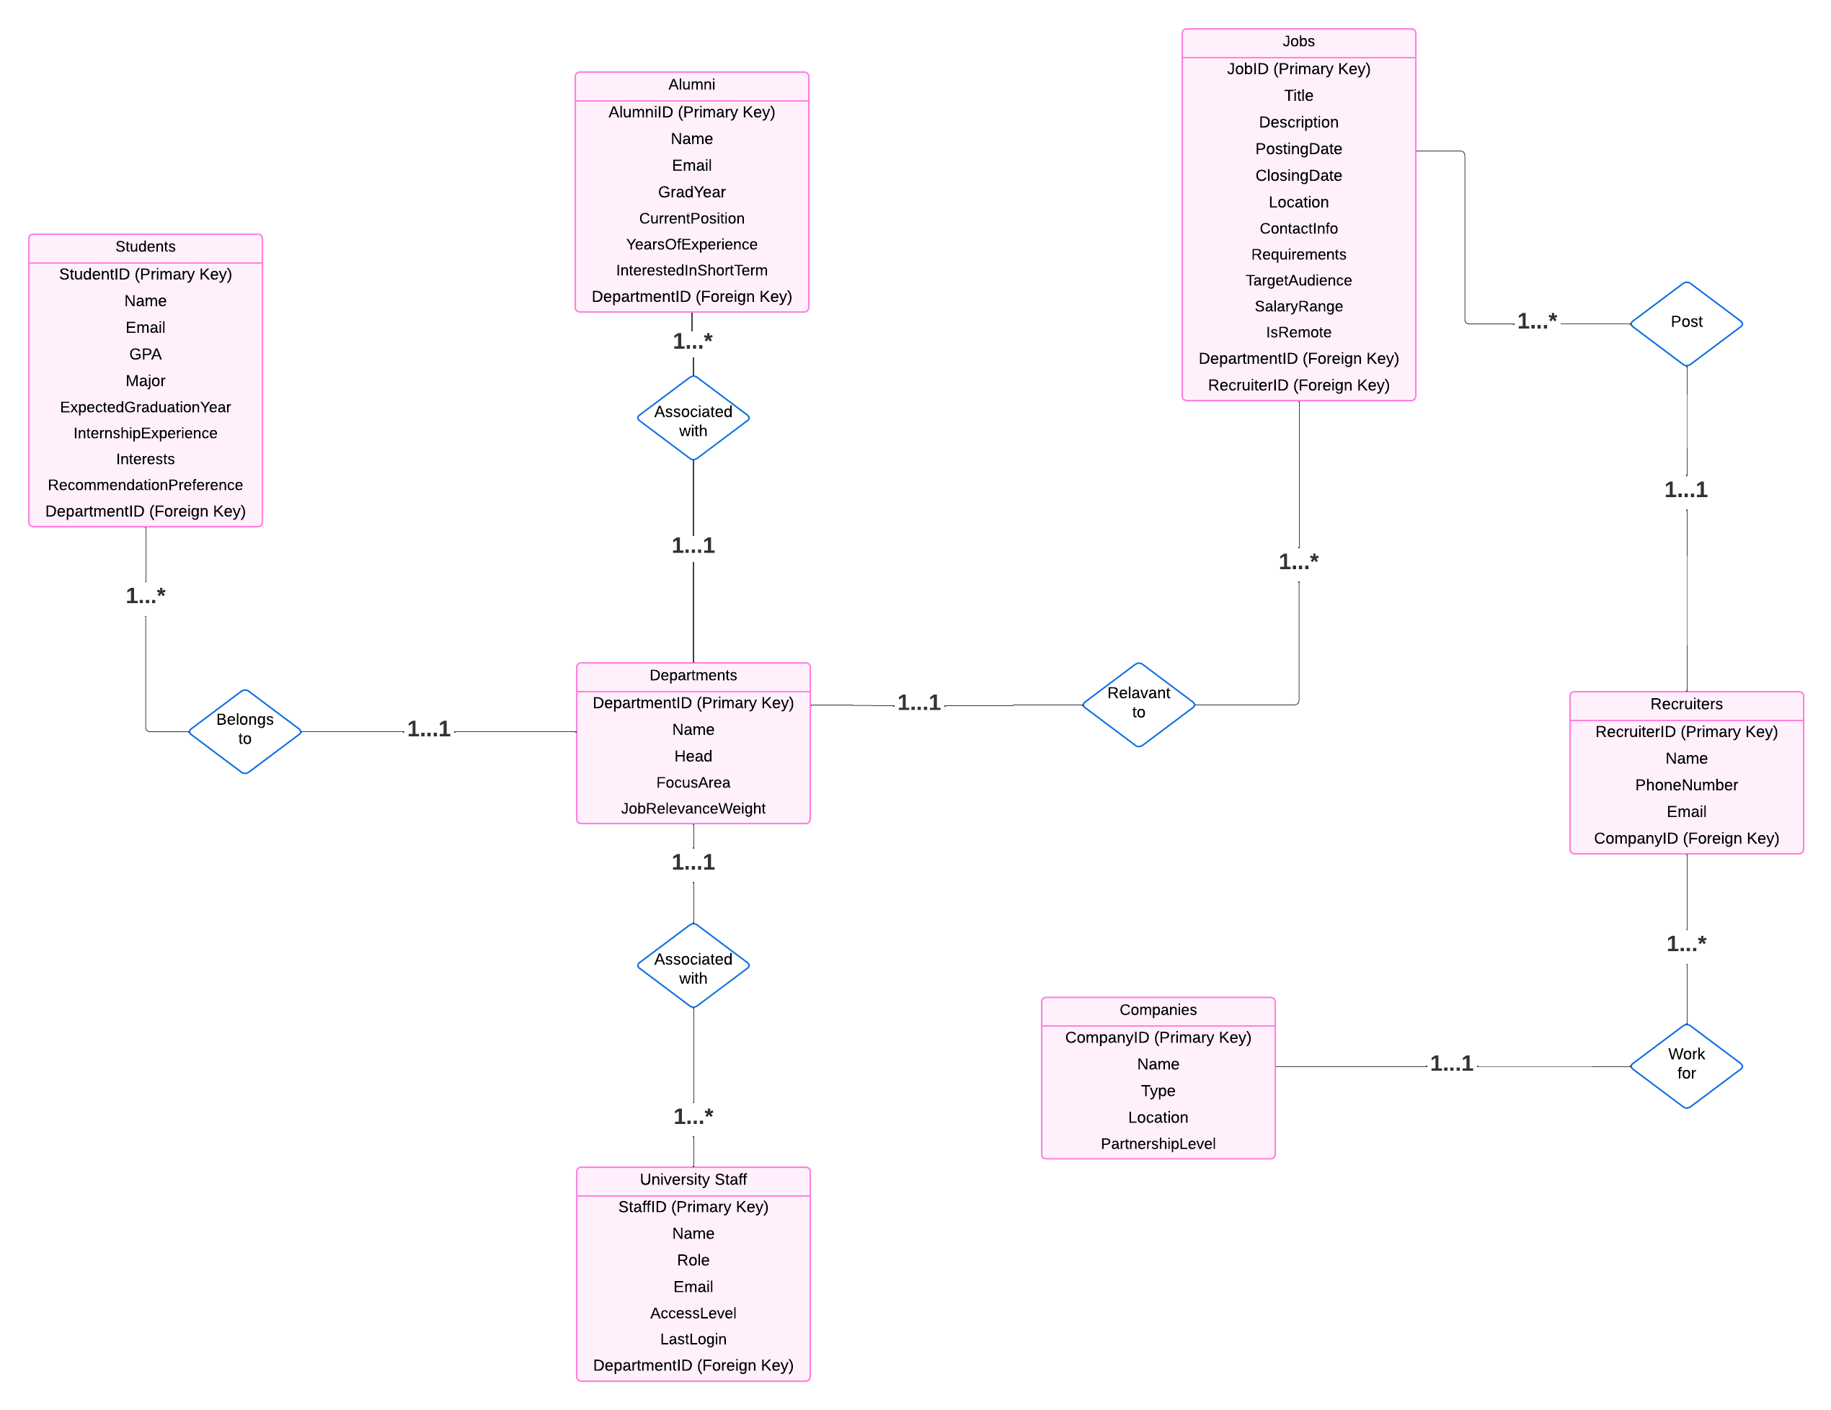
Entity Relationship Diagram

Slide 6
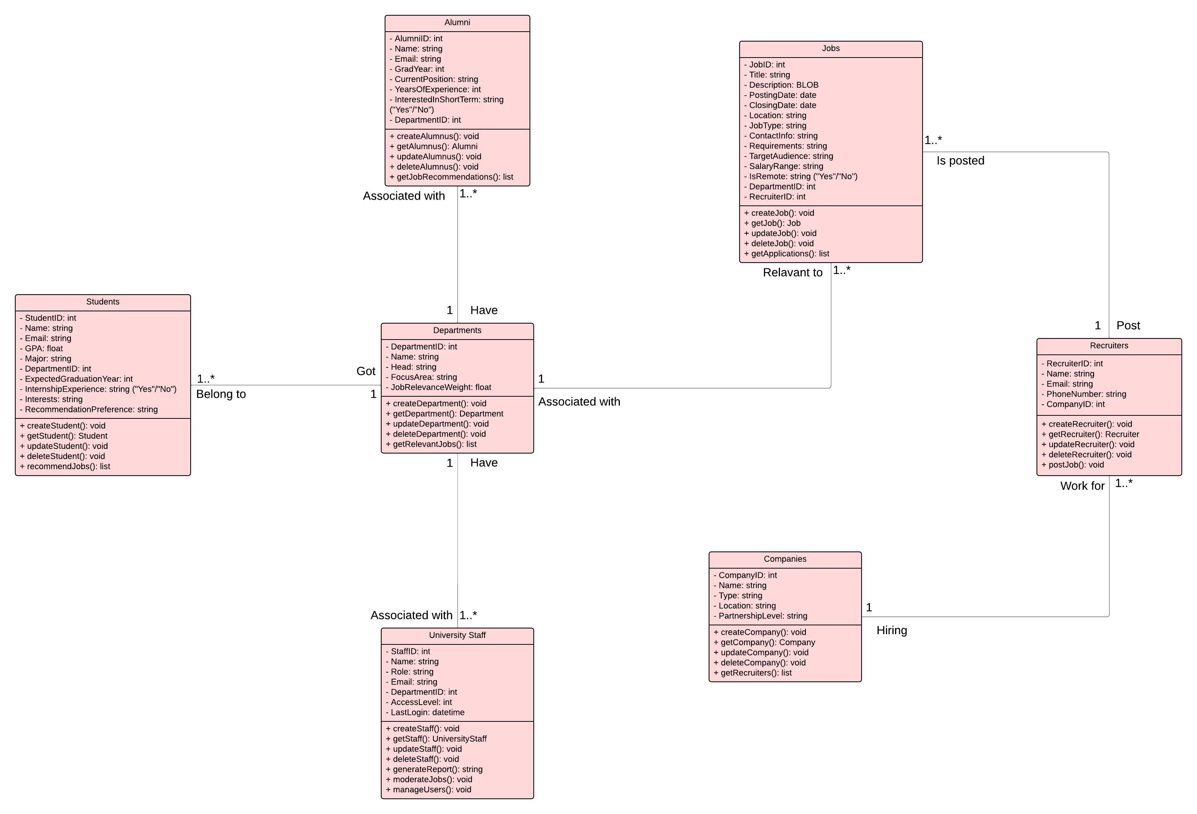
UML Diagram

Slide 7
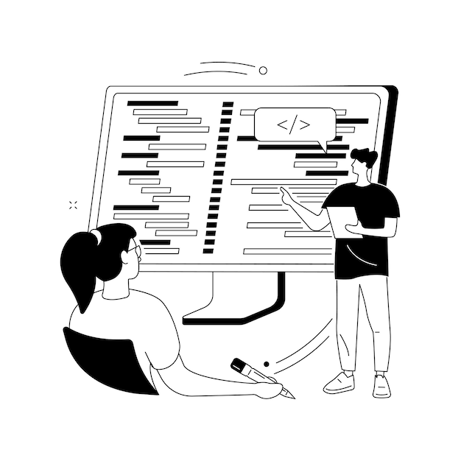



Implementation: Bringing the Design to Life
Schema Creation
SQL scripts for creating tables with constraints
Data Population
Python scripts with Faker for realistic test data, including edge cases
Indexes
Indexed fields for primary and foreign keys, optimized for common queries

Slide 8

Queries and Views: Accessing Data
1
SELECT Queries
Retrieve job recommendations for students and alumni, filter alumni by job type
2
Restricted Views
Ensure data privacy by providing role-based access to data
3
Benefits
Simplify data retrieval and maintain secure data access

Slide 9
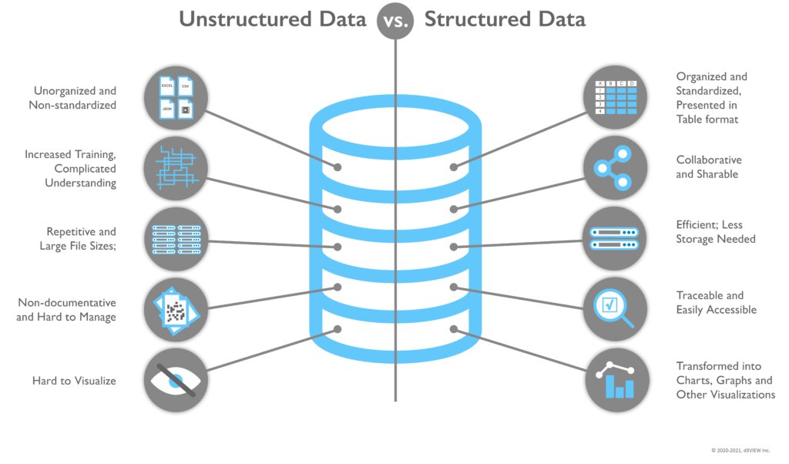



Advanced Features: Enhancing Functionality
Stored Procedures
Automate tasks such as adding a job to multiple departments or fetching alumni based on experience
Triggers
Log major changes to student data and track login activities for staff
Functions
Recommend jobs based on student preferences and department affiliations

Slide 10




Security: Safeguarding Sensitive Data
1
Role-Based Access Control
2
Restricted Views
3
Data Encryption
4
Logging

Slide 11

Testing and Performance: Ensuring Quality
100%
50%
Test Scenarios
Performance Evaluation
Cover CRUD operations, complex queries, and edge cases
Measure query execution time, optimized indexes for better performance

Slide 12
Challenges and Solutions: Lessons Learned
1
Many-to-Many Relationships
2
Realistic Test Data
3
Query Optimization

Slide 13

Conclusion and Future Work
Summary:
Achieved BCNF-compliant schema with efficient queries.
Automated processes using triggers and stored procedures.
Future Enhancements:
Develop a front-end for user interaction.
Add analytics dashboards for advanced insights.
Lessons Learned:
Importance of normalization and indexing.
Real-world challenges require iterative refinement.

Slide 14

Thank You and Q&A
I appreciate your time and interest in my presentation.
I am happy to answer any questions you may have about the database design.
Anh Tuan Hoang

